Slide 1
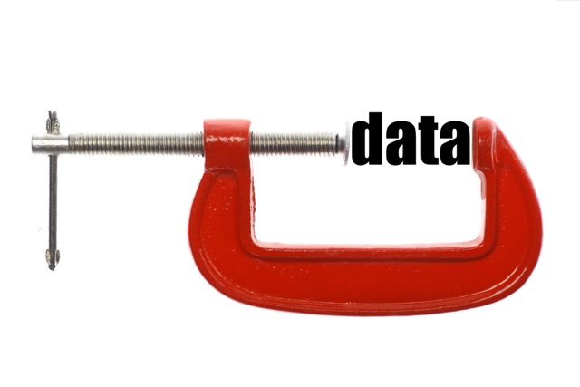
Lecture #7: Coding algorithms
Arithmetic coding (encode & decode)
NOURMIN LOUTFY

Slide 2
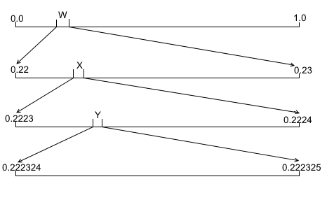

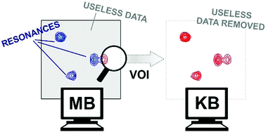
Narrowing process.
Arithmetic coding is a common algorithm used in both lossless and lossy data compression algorithms.
It is an entropy encoding technique
in which the frequently seen symbols are encoded with fewer bits than lesser seen symbols.
It has some advantages over well-known techniques such as Huffman coding

Slide 3
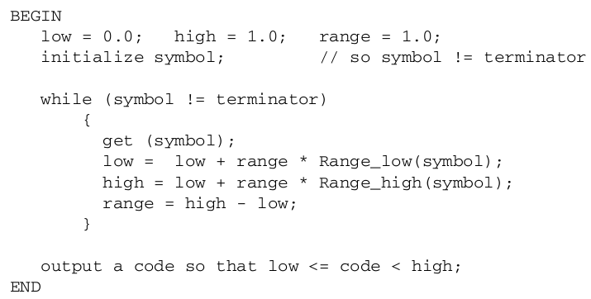
Arithmetic Coding Encoder

Slide 4
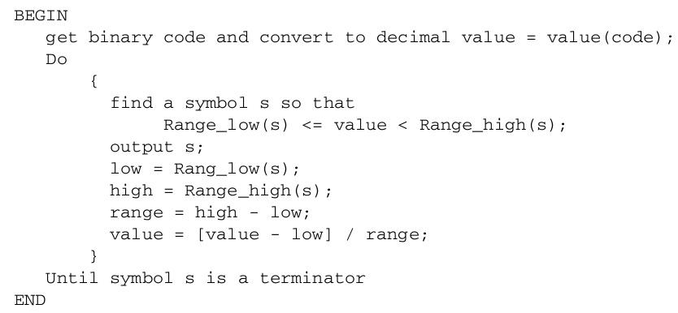
Arithmetic Coding Decoder

Slide 5
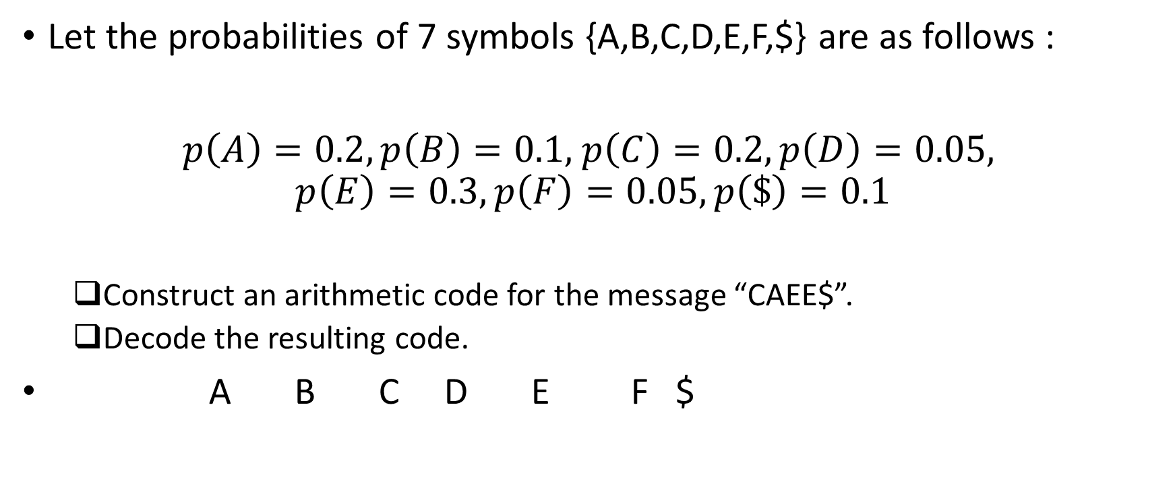
Arithmetic Coding: An Example
Let the probabilities of 7 symbols {A,B,C,D,E,F,$} are as follows :
$p\left(A\right)=0.2,p\left(B\right)=0.1,$ $p\left(C\right)=0.2, p\left(D\right)=0.05,$
$$p\left(E\right)=0.3, p\left(F\right)=0.05, p\left(\$\right)=0.1$$
Construct an arithmetic code for the message “CAEE$”.
Decode the resulting code.
A B C D E F $
0
1

Slide 6
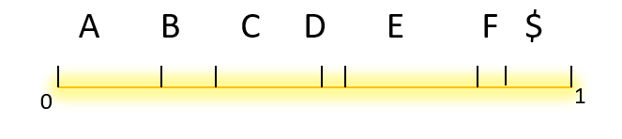
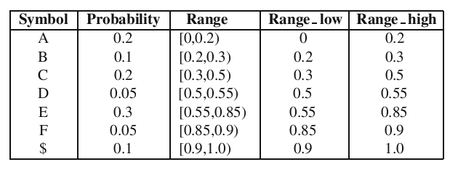
Arithmetic Coding: An Example
1. Assign a range for each symbol

Slide 7
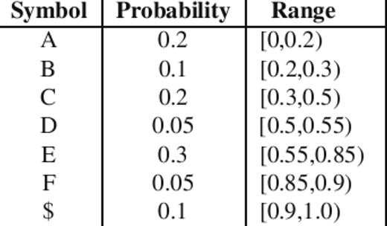
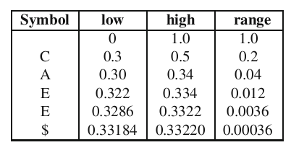
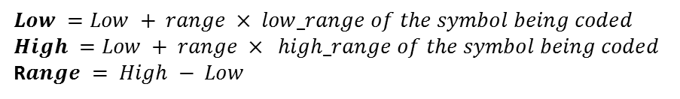
Arithmetic Coding: An Example
2. Prepare New low, high, and range for the symbols of the message:
3. Generate a final code which is a number in between [0.33184,0.33220).
Say 0.33203125. →
$$Low =Low + range × low_range of the symbol being coded$$
$$High =Low + range × high_range of the symbol being coded$$
R$ange = High − Low$

Slide 8
0.3
0
0.5
1.0
0.3
0.5
0.34
0.3
0.322
0.334
0.34
0.3286
0.322
0.3322
0.334
0.3286
0.33184
0.3322
0.33184
0.33184
0.3322
0.3322

Slide 9
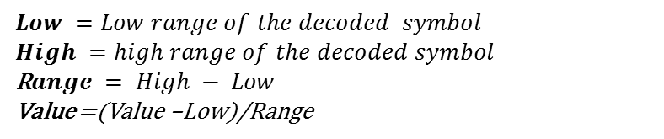
Arithmetic Coding: An Example
4. At the destination side, decode the binary number 0.01010101
$$Low =Low range of the decoded symbol$$
$$High =high range of the decoded symbol$$
R$ange = High − Low$
Value =(Value –Low)/Range

Slide 10


